Slide 1
BLOCKCHAIN CONSENSUS SIMULATOR
CANAY TAŞAR
HANİFE HAZEL GÜLLER
M.MUSTAFA ERCAN
YAĞMUR EBRAR ÖZYURT
Advisor: Öğr. Gör. Dr. Faris Serdar TAŞEL

Slide 2
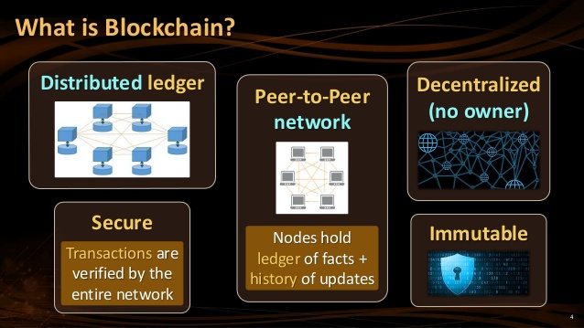
What is an Blockchain ?
Blockchain is a shared, trusted, public ledger of transactions that everyone can inspect but which no single user controls.
is used in many different areas such as banking, real estate sector and education.

Slide 3
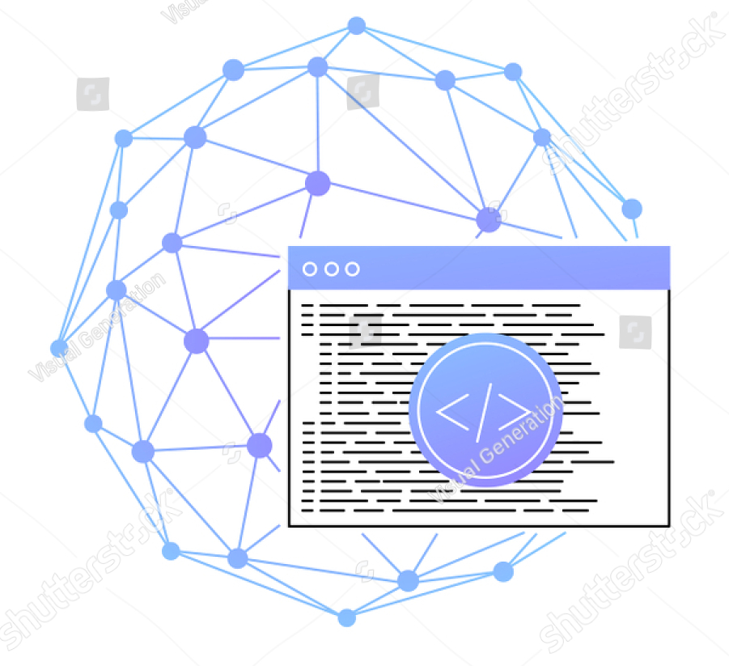
Project Description
Goal in this project is to model and simulate Blockchain by running a real process or system in a specific time frame.

Slide 4
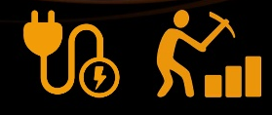
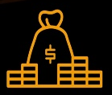
Problem Statement
Consensus is needed to send money in the blockchain. People need to establish their own consensus for the approval process because of the problem of trust. The structure of this control also makes blockchain. We looked at the most popular consensus mechanisms of the POW and POS algorithms, and we found that none of them were absolutely perfect, but that each had power. Therefore, algorithms must be updated and completed continuously.

Slide 5
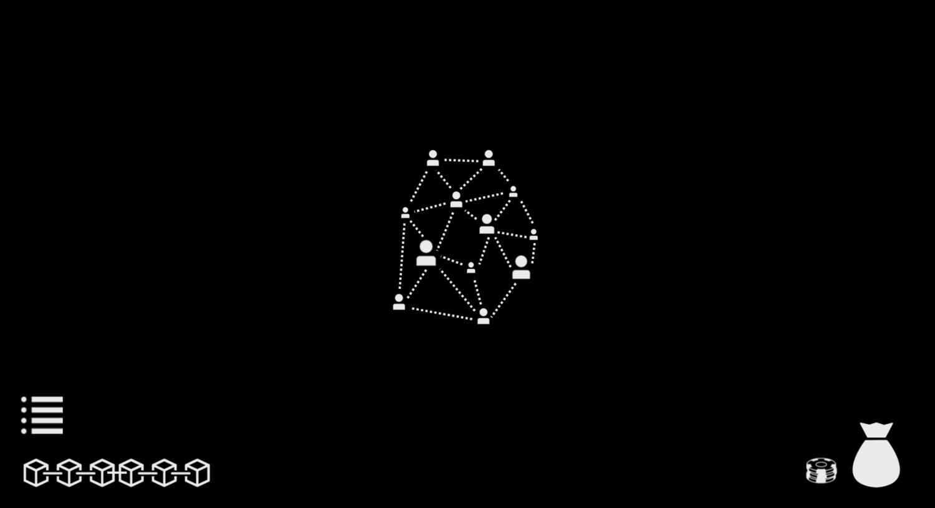
Solution Statement
Our project aim is to model and simulate Blockchain for a real process or system to work within a certain period of time. We will examine how we connect the network. We will determine the connection of the nodes, the number of nodes and how much they are connected. We will determine which algorithms will work in network. We'll check the transaction fee range.

Slide 6
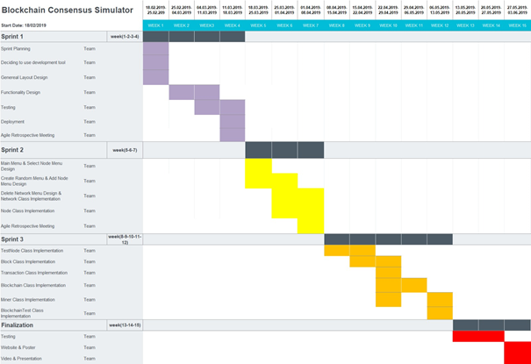
Development Methodology
For developing the project, we have planned to use Scrum which is an agile software development methodology.
Figure 1 - Work Plan

Slide 7
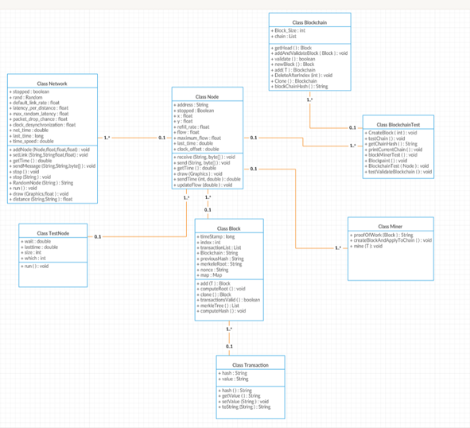
Figure 2 - Class Diagram

Slide 8
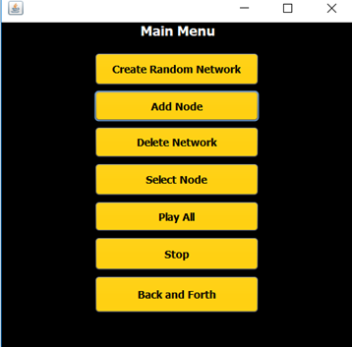
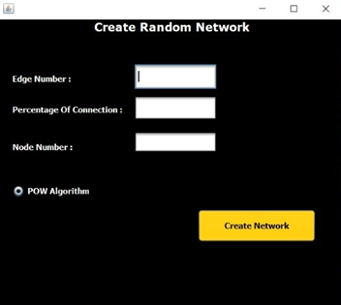
Help System Design
Figure 3 - Main Page
Figure 4 - Create Random Network Page

Slide 9
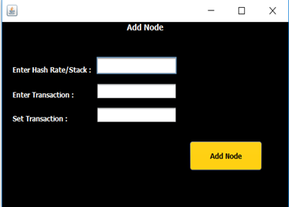
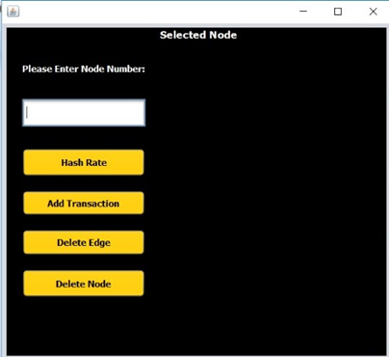
Help System Design (Cont.)
Figure 5 - Add Node Page
Figure 6 - Select Node Page

Slide 10
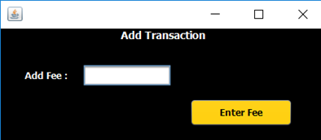
Help System Design (Cont.)
Figure 7 - Add Transaction Page

Slide 12
Conclusions
Blockchain is a shared, trusted, public ledger of transactions, that everyone can inspect but which no single user controls.We have examined the most popular consensus mechanisms POW algorithms and we find out that none of them is absolutely perfect but they each have their strengths. That’s why algorithms are being continuously updated and complemented. Sometimes the approaches from even different consensuses mix together forming hybrids

Slide 13
